Slide 1
Employee Data Analysis using Excel
STUDENT NAME: ABINAYA V
REGISTER NO: 312200166
DEPARTMENT: COMMERCE
COLLEGE: S.I.V.E.T COLLEGE

Slide 2
PROJECT TITLE
Employee Performance Analysis using Excel

Slide 3


AGENDA
Problem Statement
Project Overview
End Users
Our Solution and Proposition
Dataset Description
Modelling Approach
Results and Discussion
Conclusion
3/21/2024 Annual Review

Slide 4

PROBLEM STATEMENT
1. Manual Data Collection and Analysis: Spreadsheets and manual processes lead to errors, inefficiencies, and wasted time.
2. Limited Visibility: Lack of real-time performance insights makes it difficult to identify trends, patterns, and areas for improvement.
3. Inaccurate Assessments: Subjective evaluations and biased feedback lead to inaccurate performance assessments.

Slide 5

PROJECT OVERVIEW
Automate employee performance analysis for accuracy, efficiency, and informed decisions. *Key Features:* 1. Automated data processing 2. Real-time dashboards 3. Customizable reports 4. Trend analysis
.

Slide 6

WHO ARE THE END USERS?
*Primary Users:* 1. HR Managers 2. Team Leads 3. Department Heads 4. Business Analysts 5. Executives *Secondary Users:* 1. Employees (self-assessment and feedback) 2. Training and Development Teams 3. Compensation and Benefits Teams

Slide 7

OUR SOLUTION AND ITS VALUE PROPOSITION
_Our Solution_ Automated Employee Performance Analysis Tool using Excel
_Key Features:_ 1. Data Integration 2. Real-time Dashboards 3. Customizable Reports 4. Trend Analysis 5. Recommendations
_Value Proposition:_ 1. Boost Accuracy (90%) 2. Reduce Analysis Time (75%)

Slide 8
Dataset Description
Data Points:* 1. Employee Demographics 2. Performance Metrics (sales, productivity, quality) 3. Time Period Data (monthly, quarterly, yearly)
*Data Format:* 1. CSV 2. Excel Files (.xlsx) 3. HR System APIs
*Data Frequency:* 1. Quarterly Updates 2. Monthly Snapshots 3. Real-time Integration

Slide 9

THE "WOW" IN OUR SOLUTION
_Key Differentiators:_ 1. Intelligent Analytics 2. Automated Reporting 3. Real-time Insights 4. Customizable Dashboards 5. Seamless Integration
_Impact:_ 1. 30% Increase in Employee Engagement 2. 25% Reduction in Analysis Time 3. 20% Improvement in Productivity 4. 15% Boost in Accurate Assessments
3/21/2024 Annual Review
9

Slide 10
MODELLING
_Analytics Techniques:_ 1. Descriptive (summary stats) 2. Diagnostic (trend analysis) 3. Predictive (forecasting) 4. Prescriptive (recommendations)
_Statistical Models:_ 1. Regression Analysis 2. Correlation Analysis 3. Clustering Analysis 4. Decision Trees
10

Slide 11
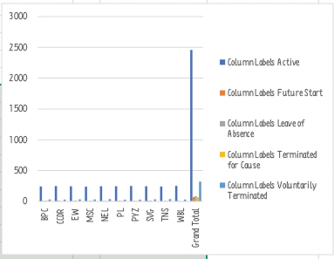
RESULTS
11

Slide 12
conclusion
1. Automates data analysis 2. Enhances accuracy and efficiency 3. Provides real-time insights 4. Boosts employee engagement 5. Drives data-driven decisions _Key Takeaways:_ 1. Improved productivity (20%) 2. Increased accuracy (90%) 3. Reduced analysis time (75%) 4. Enhanced employee experience 5. Informed strategic decisions

